Slide 1
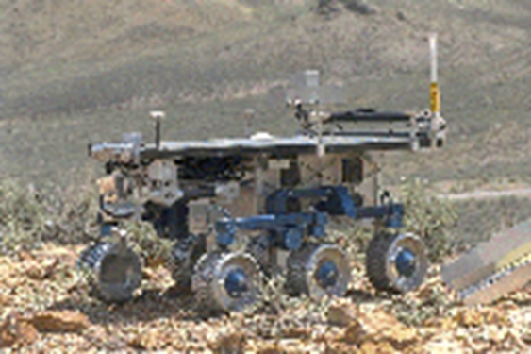


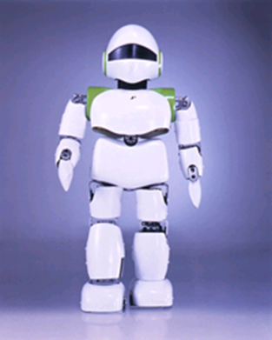
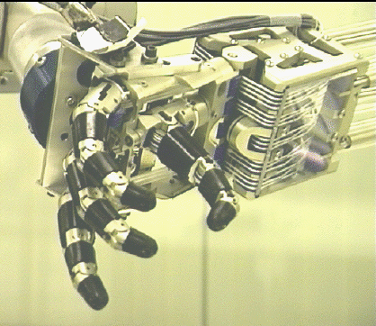
Introduction to Robot Operating System

Slide 2
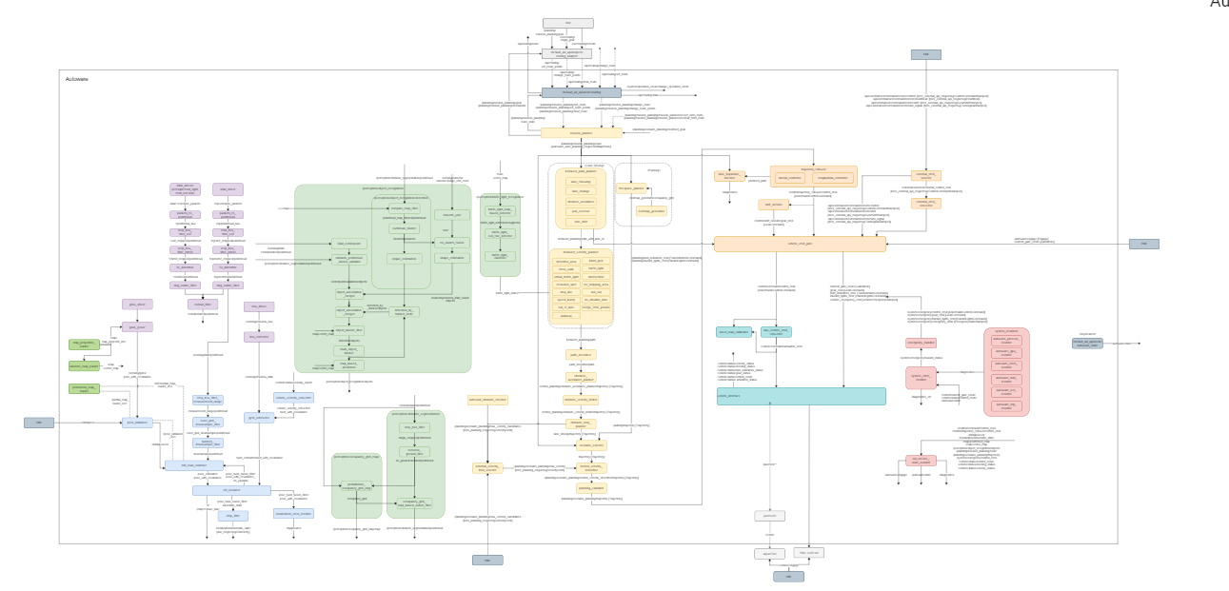
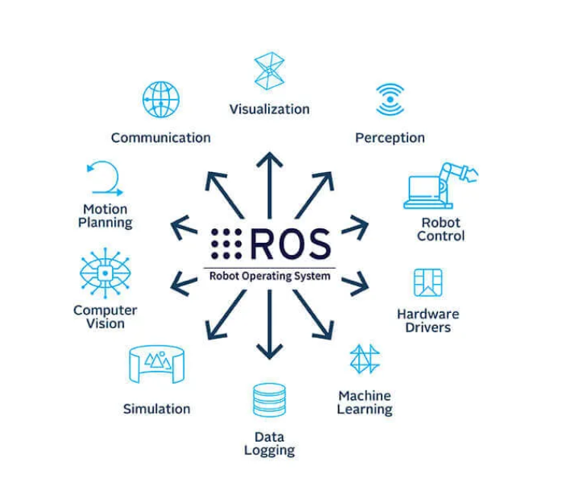
What is a ROS?
The Robot Operating System (ROS) is not an actual operating system, but a framework and set of tools that provide functionality of an operating system on a heterogeneous computer cluster.
Why should we use ROS in Robotics?
ROS is that it simplifies the development and integration of complex robotics systems, by providing a common interface and standard for communication and coordination between nodes.
-Connect components made in various programming languages by just implementing the proper connectors to the messaging system, making it easy to develop software by connecting existing modules from various developers.
-Create nodes over a network of devices, without worrying about where code is run.

Slide 3
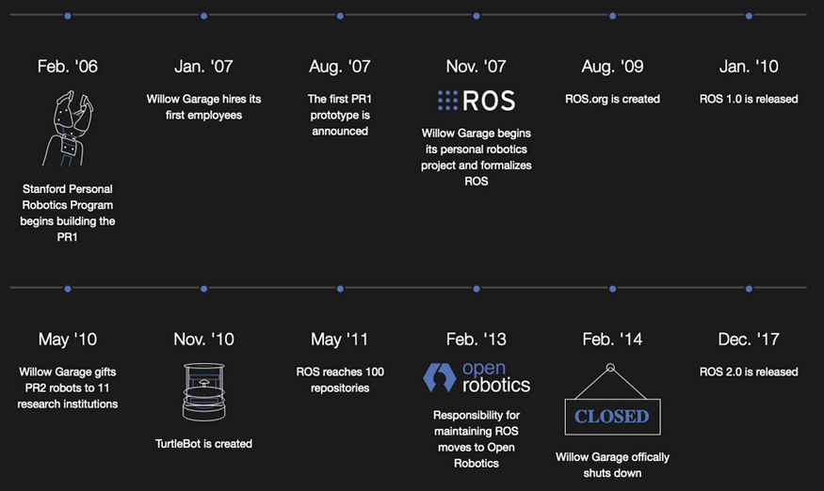
History of ROS?

Slide 4
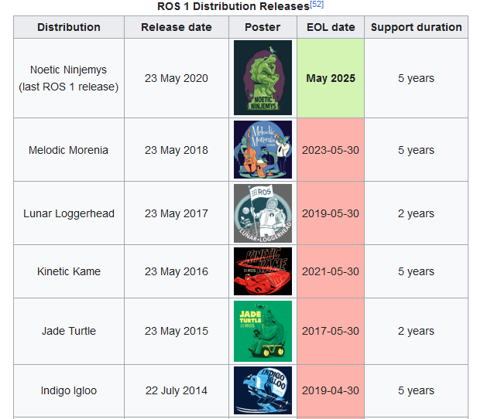
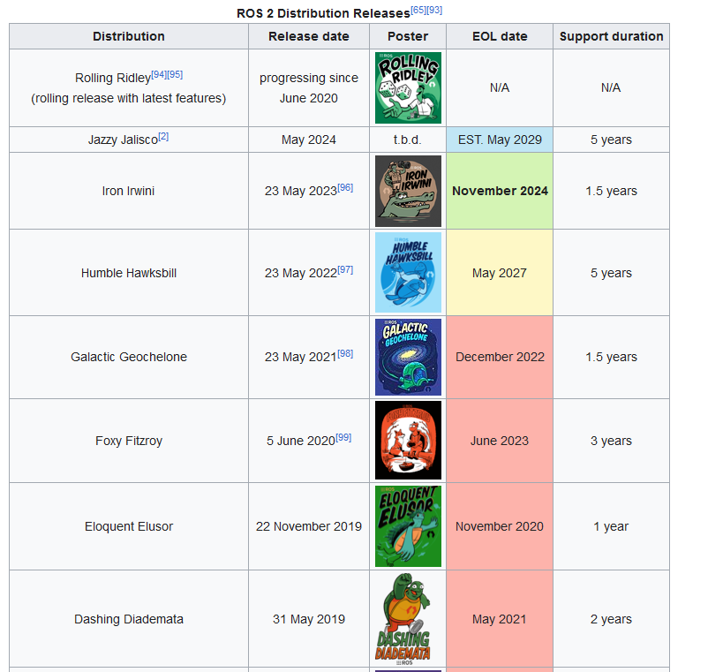
History of ROS?

Slide 5
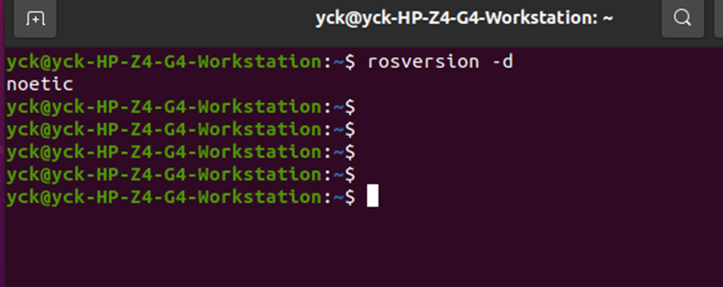
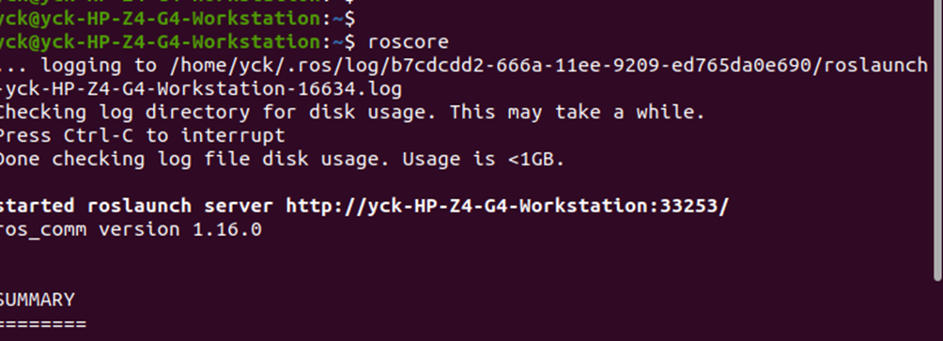
ROS Commands

Slide 6
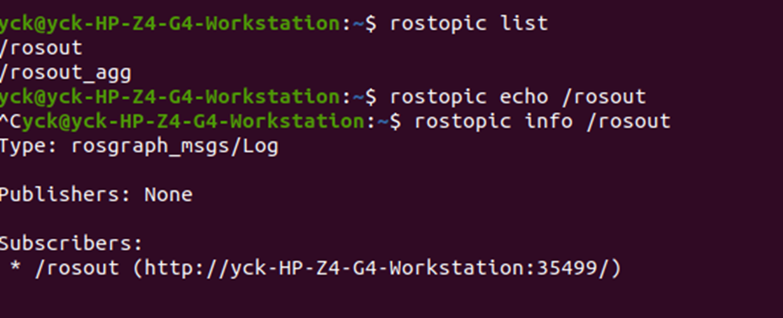
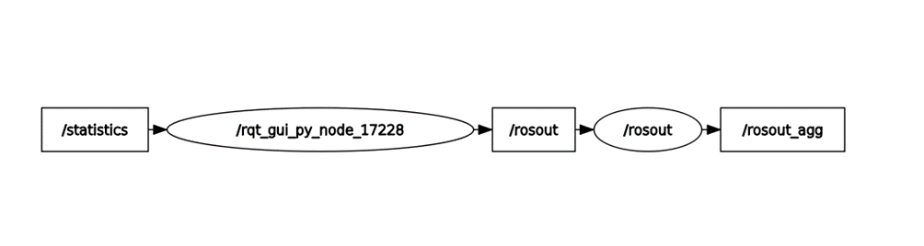
ROS Commands /Topic and Nodes

Slide 7

ROS Commands /Topic and Nodes

Slide 8
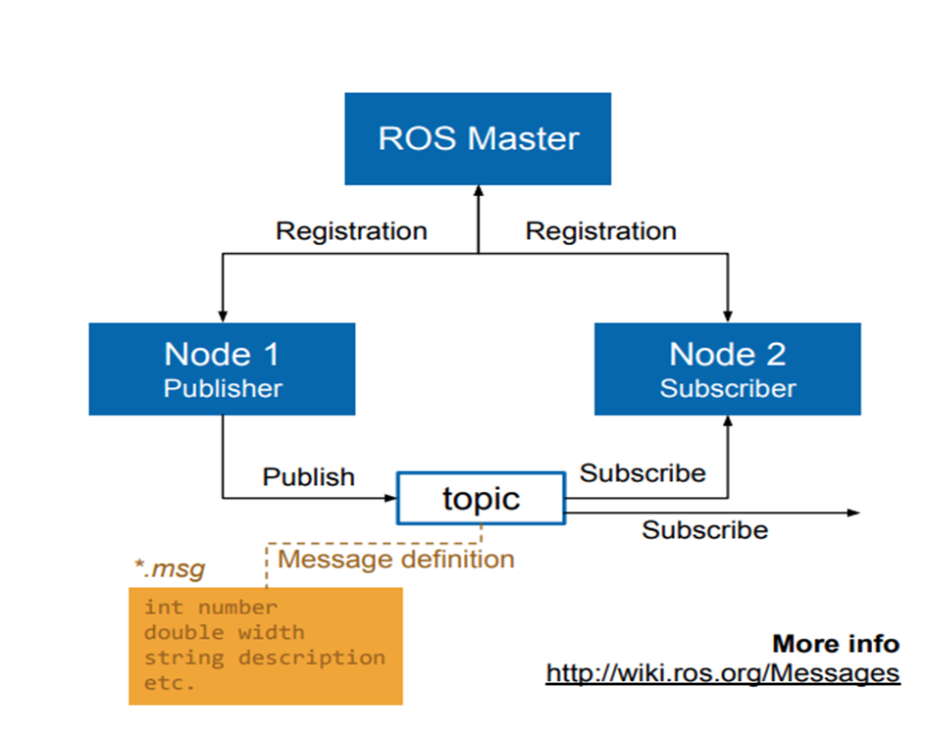
ROS Commands /Topic and Nodes

Slide 9
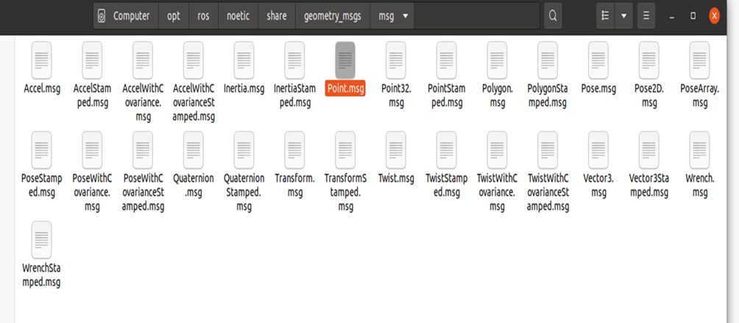
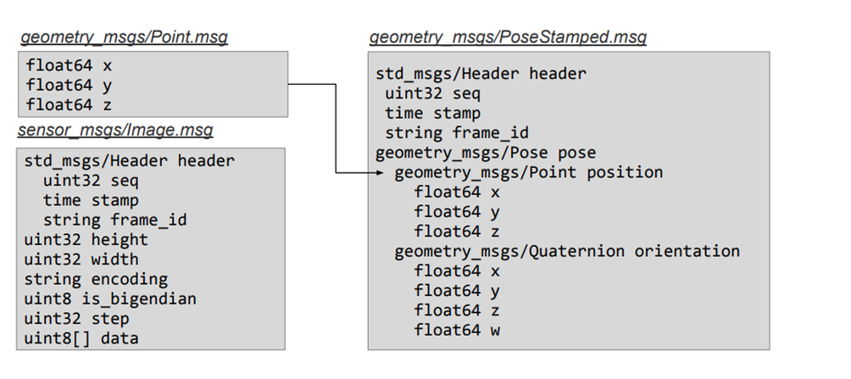
ROS Commands /Topic and Nodes

Slide 10
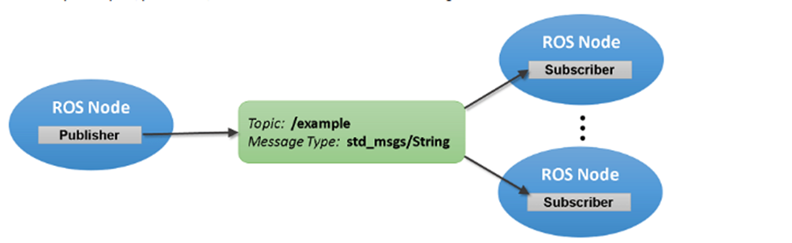
ROS Commands /Topic and Nodes

Slide 11
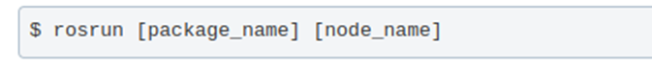
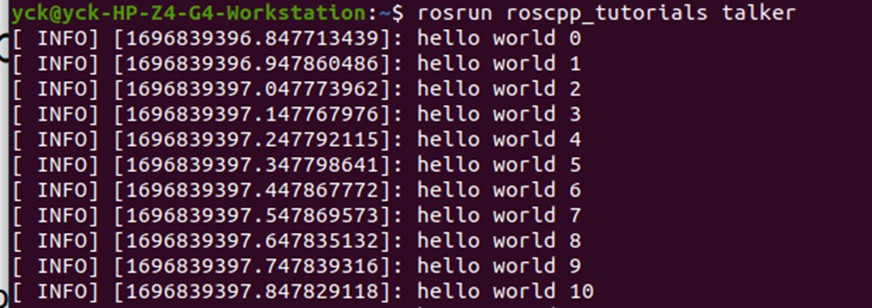
ROS Commands /Topic and Nodes

Slide 12
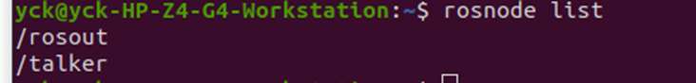
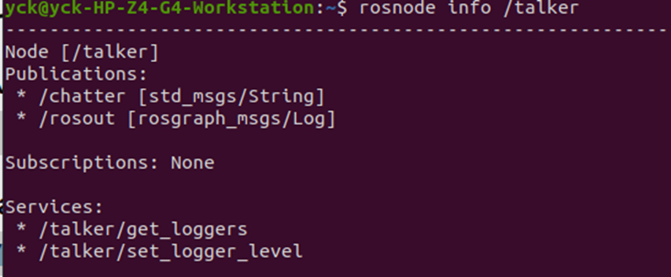
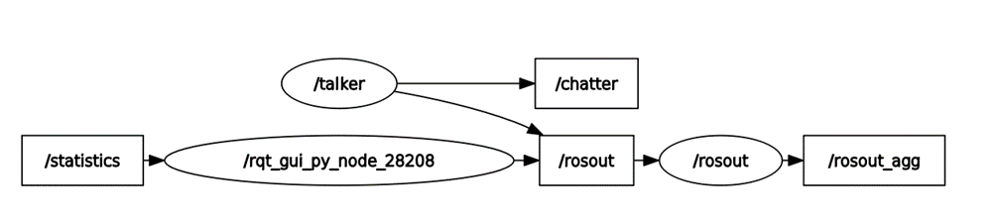
ROS Commands /Topic and Nodes

Slide 13
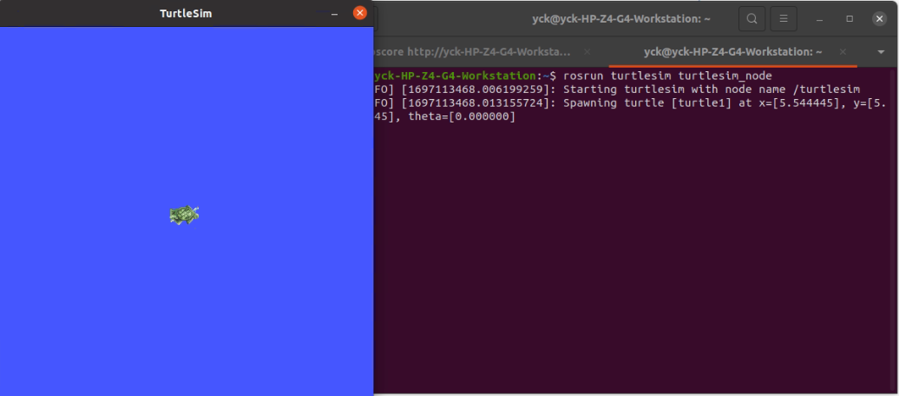
ROS Commands /Topic and Nodes

Slide 14
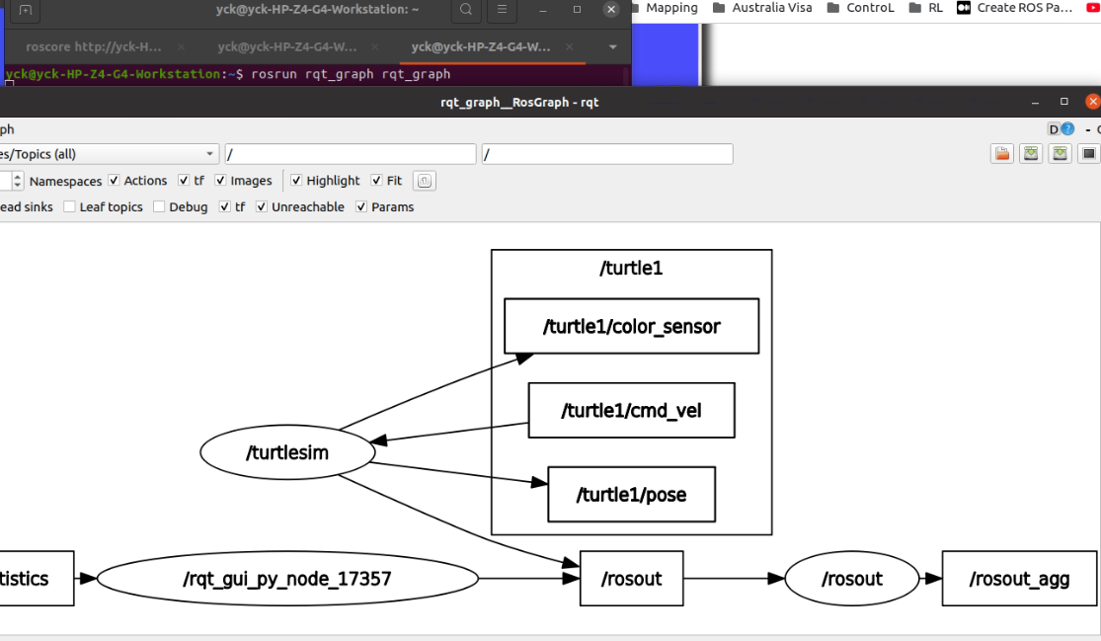
ROS Commands /Topic and Nodes

Slide 15
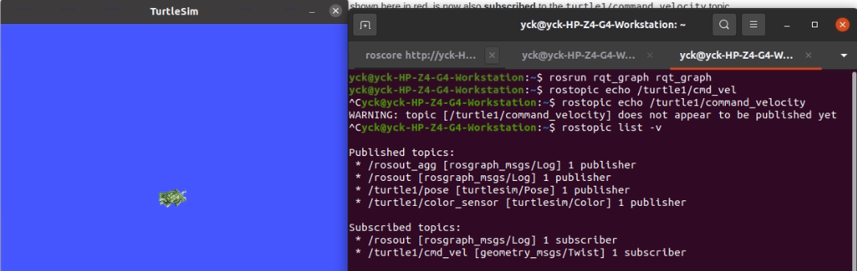
ROS Commands /Topic and Nodes

Slide 16
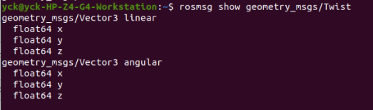
ROS Commands /Topic and Nodes

Slide 17
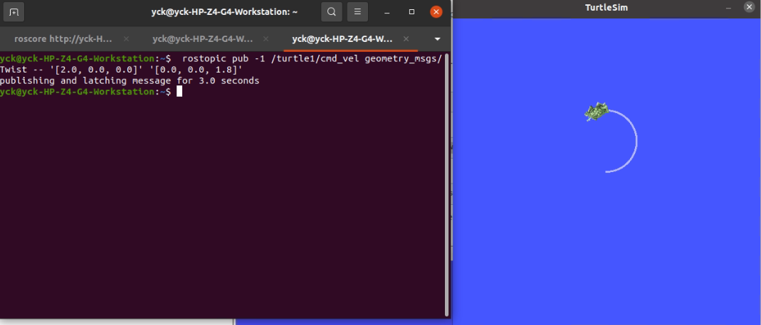
ROS Commands /Topic and Nodes

Slide 18
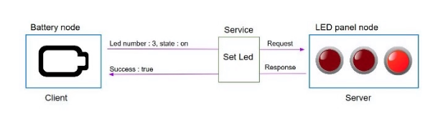
ROS Commands /Services
-A ROS service is a client/server system. (ROS Server / ROS Client)
-It is synchronous. The client sends a requests, and blocks until it receives a response from server. For example if you want to enable or disable an actuator, or any immediate action.
- Not like a topic, service is one-time communication

Slide 19
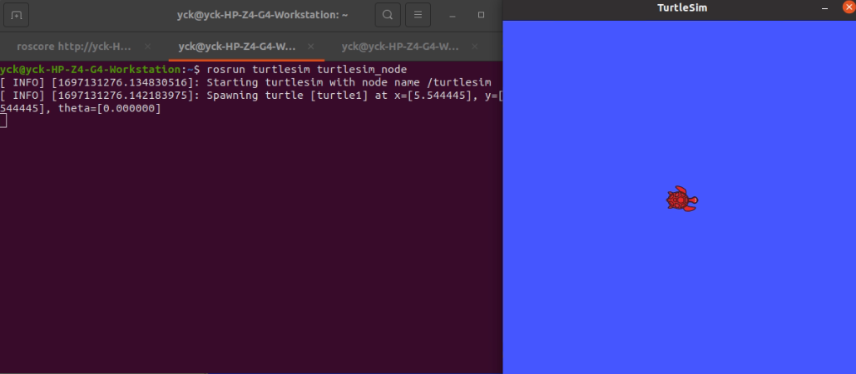
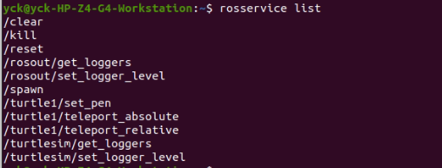
ROS Commands /Services

Slide 20
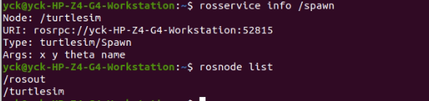
ROS Commands /Services
The service is provided by the node, /turtlesim
URL where the service is located in the port number
Type of the message, turlesim/spawn
The argument, the client when it sends a request it must send the arguments

Slide 21
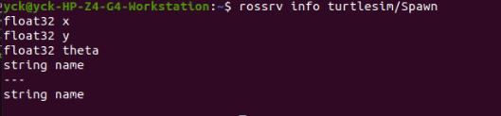
ROS Commands /Services

Slide 22
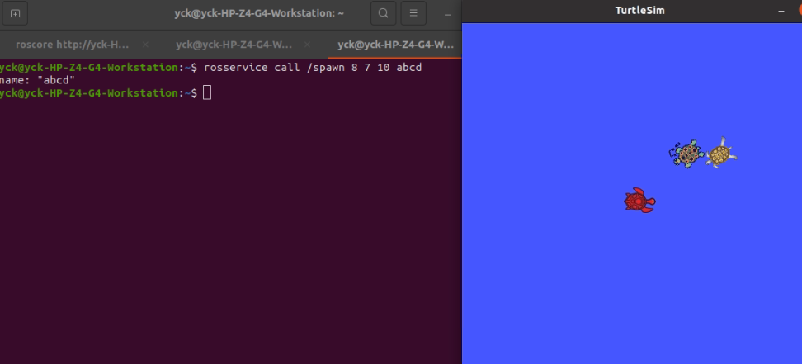
ROS Commands /Services

